Slide 1
Module 4: POINTERS
COMPUTER PROGRAMMING 2 FOR IT

Slide 2
POINTERS
Pointer
A variable that holds a memory address. Syntax:
Type_Name *Pointer_1, *Pointer_2, . . ., *Pojnter_n;
Declaring a pointer is just like declaring an ordinary variable of a certain type.
int *p1, *p2, v1, v2;
p1 and p2 are pointers
v1 and v2 are variable

Slide 3
Declaring pointer variable
Declaration | Description
int *p; | pointer that points to a variable of type int
float *p; | pointer that points to a variable of type float
double *p; | pointer that points to a variable of type double
MyType *p; | pointer that points to a variable of type MyType Class

Slide 4
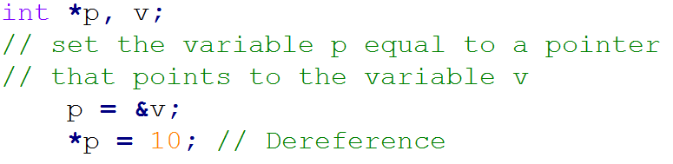
& symbol
It is used to return the address of a variable.

Slide 5
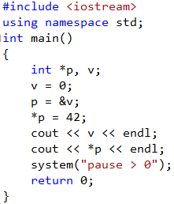
Source Code Example:
Output:

Slide 6
The * operator in front of a pointer variable produces the variable to which it points. When used this way, the * operator is called the dereferencing operator.
The & in front of an ordinary variable produces the address of that variable; that is, it produces a pointer that points to the variable. The & operator is simply called the address-of-operator.

Slide 7
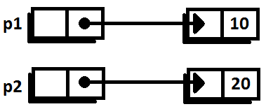
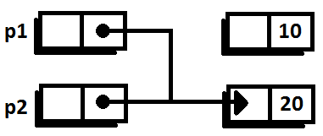
Use of assignment operator with pointer variables
p1 = p2;
Before:
After:

Slide 8
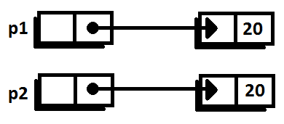
*p1 = *p2;
Before:
After:

Slide 9
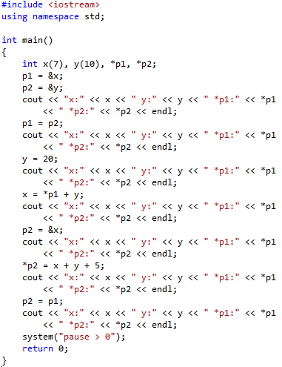

Source Code Example:
Output:

Slide 10
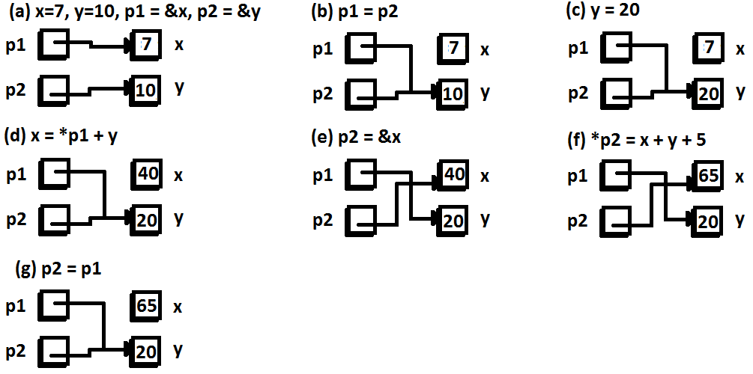
Illustration:

Slide 11
new operator
Since a pointer can be used to refer to a variable, your program can manipulate variables even if the variables have no identifiers to name them.
The new operator creates a new dynamic variable of a specified type and returns a pointer that points to this new variable.

Slide 12

Example of new operator:
This new, nameless variable can be referred to as *p1 (that is, as the variable pointed by p1)
If the possible output would be like this

Slide 13
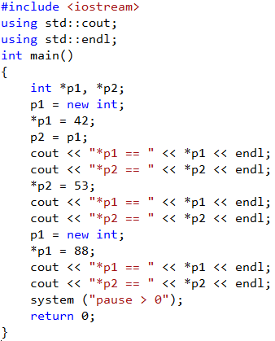

Source Code Example
Output:

Slide 14
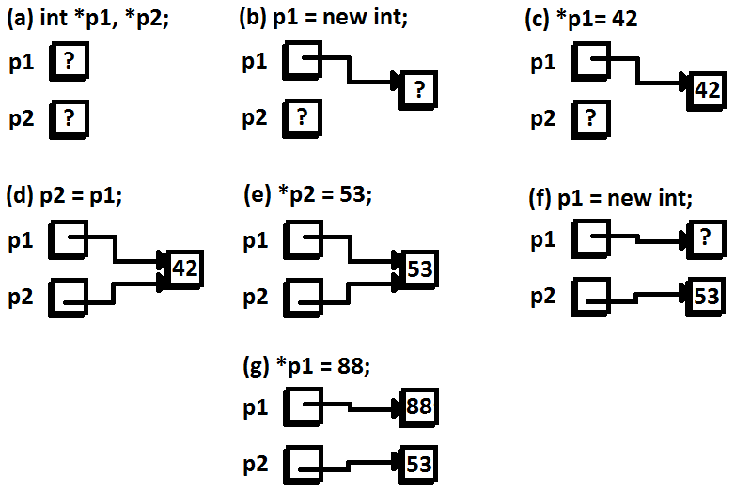
Illustration:

Slide 15
Type Definitions
You can assign a name definition and then use the type name to declare variables using typedef keyword.
Syntax:

Slide 16
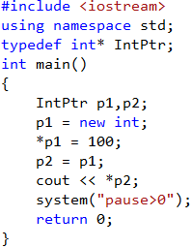
Example Source Code:
        Output:

Slide 17
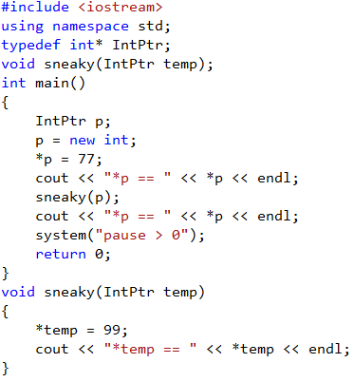

Pointers as Call-by-Value
Output:

Slide 18
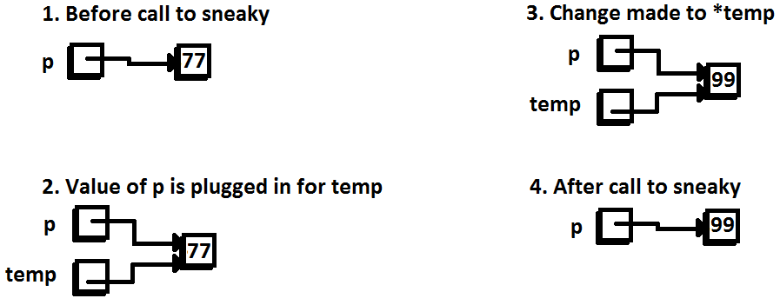
Illustration:

Slide 19



Dynamic Arrays (Dynamically allocated array)
Is an array whose size is not specified when you write the program, but is determined while the program is running.
legal:
illegal:

Slide 20
An array variable is not of type int*, but its type is a const version of int*. An array variable, like a, is a pointer variable with the modifier const, which means that its value cannot be changed.

Slide 21
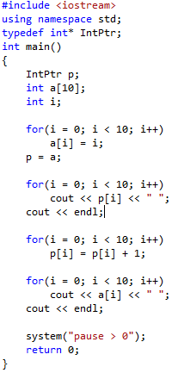
Sample Source Code
Output:

Slide 22
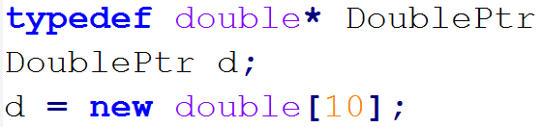
Pointer Arithmetic
d contains the address of the indexed variable d[0]. The expression d + 1 evaluates to the address of d[1], d + 2 is the address of d[2], , and so forth.

Slide 23
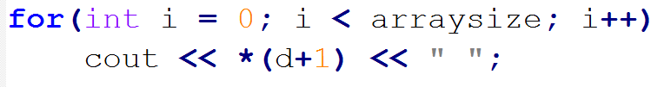

i
is equivalent to:

Slide 24
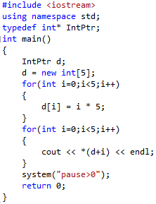
Example Source Code:
Output:

Slide 25
SEATWORK

Slide 26
// my first pointer #include <iostream.h> int main () { int firstvalue, secondvalue; int * mypointer; mypointer = &firstvalue; *mypointer = 10; mypointer = &secondvalue; *mypointer = 20; cout<<"firstvalue is “<<firstvalue<<endl; cout<<"secondvalue is “<<secondvalue<< endl; return 0; } | Output: firstvalue is 10 secondvalue is 20

Slide 27
// more pointers #include <iostream.h> int main () { int firstvalue = 5, secondvalue = 15; int * p1, * p2; p1 = &firstvalue; p2 = &secondvalue; *p1 = 10; *p2 = *p1; p1 = p2; *p1 = 20; cout << "firstvalue is " << firstvalue << endl; cout << "secondvalue is " << secondvalue << endl; return 0; } | Output: firstvalue is 10 secondvalue is 20

Slide 28
// more pointers #include <iostream.h> int main () { int numbers[5]; int * p; p = numbers; *p = 10; p++; *p = 20; p = &numbers[2]; *p = 30; p = numbers + 3; *p = 40; p = numbers; *(p+4) = 50; for (int n=0; n<5; n++) cout << numbers[n] << " "; return 0; } | Output: 10 20 30 40 50

Slide 29
End of Module 4

